Slide 1





oNGO
Open Platform to connect NGO/Needy People, Volunteers and Philanthropists
By
Global Society Makers
2014, Oct 12

Slide 2
Introduction – Global Society Makers
An Indian NGO created to make a balanced and better society by focusing on following six primary areas
Education
Healthy Living
Environment Care
Rural empowerment
Organic Farming
Heritage
Received more than 15 National and International awards for best rural development organization
We reach out to students, farmers, rural women and needy people
We provide in-kind as well as monetary support on need basis

Slide 3
Problem Domain
3.3 million NGOs in India [raises between $8 to $16B every year]
Creating a responsive portal interface for even 10% of these NGOs will incur ~13 billion INR*
Operational excellence as well as consolidation of NGOs
Lack of systematic approach to motivate the volunteer
*~40,000 INR needed per dynamic website creation with basic modules

Slide 4
Pain Points
NGO / Needy People
Not able to reach the right set of people
No standard volunteer group
No standard system to manager their operation
Philanthropists
Lack of transparency in NGO operation
No one stop solution for 80G receipts
Authenticity of the Appeals
Lack of awareness / inaccessible to the needy people
Volunteers
Lack of interesting projects / appeals
Lack of reward system
Less accessibility
Expensive IT solution
Not enough challenges in the pipeline
Can spend only limited amount of time

Slide 5
Solution Our Methodology
an open source application can be used by any NGO to achieve operational excellence and save time / money
a dynamic workflow system to connect all the dots and various types of needs
the various types of data to generate a heat map and help the NGOs / good hearts to make informed decision
a future ready platform for better scalability and availability
a framework to capture the basic human problems
The solution to implement capture the problems to solve it !
oNGO
Capture
Build
Implement
Publish
Develop
Spread

Slide 6
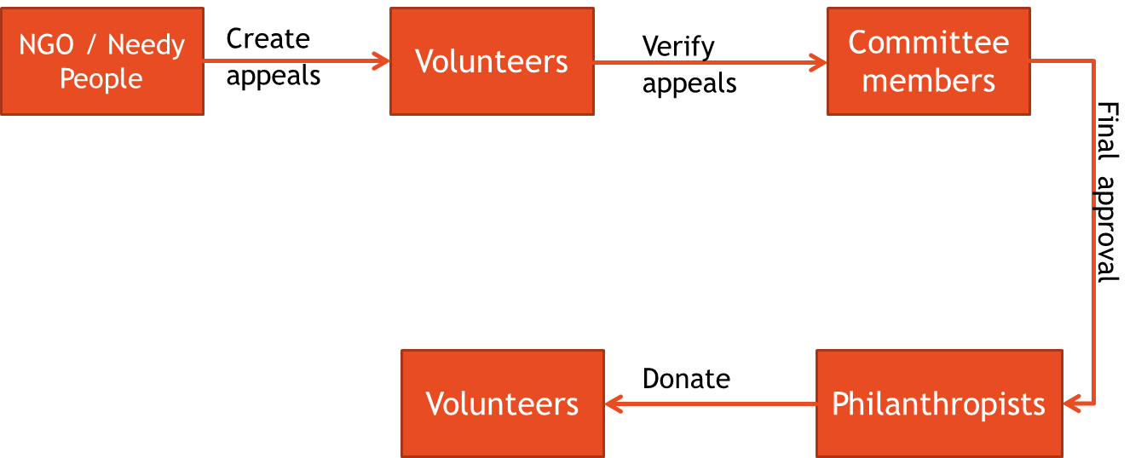
Key Benefits
Open Standards for the NGO operations like Appeal creation, verification, receipt generation, Communications, etc
Gamified environment to create buzz in volunteer and philanthropists
Focused/Specific communication system
Highly customizable workflow based system to tailor made the appeal process
Future Ready technology Stack for high portability
API based system will help us in building any device and offline computing
Publishing this as open source platform will enable other developers to contribute for a better environment

Slide 7
Why PayPal
Known for philanthropy / Innovation / Technology
Created and published many standards in the past
Always focused on enabling people
PayPal will surely bring in more visibility to the dark area of NGO operations today in India
Win-win solution for PayPal as well as all the NGOs if we start using the PayPal donate functionality
Global payment leader

Slide 8
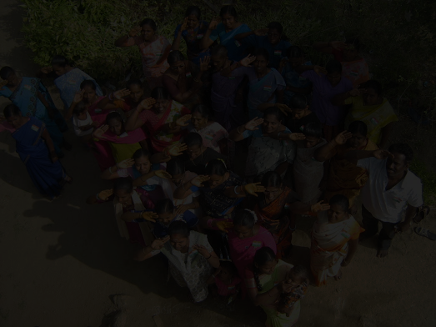
Thank You PayPal ! Lets connect the disconnected dots to create a better eco system !
while(true) {
try { // Closed Loop Continuous Improvement System
open_reference_standard(oNGO::Platform);
}
catch(doubts, disbelief, sarcasm, …) {
ignore_all();
}
catch(ideas, thoughts, feedback, suggestions, …) {
absorb_internalize_transform();
}
}

Slide 9
Modules
User/NGO SignUp
Authentication
Event Management
Appeal Management
Search NGO
List Events Specific to NGO
Workflow System
Cause Management
Profile Management
Receipt Management
Angel Points
Subscriptions

Slide 10
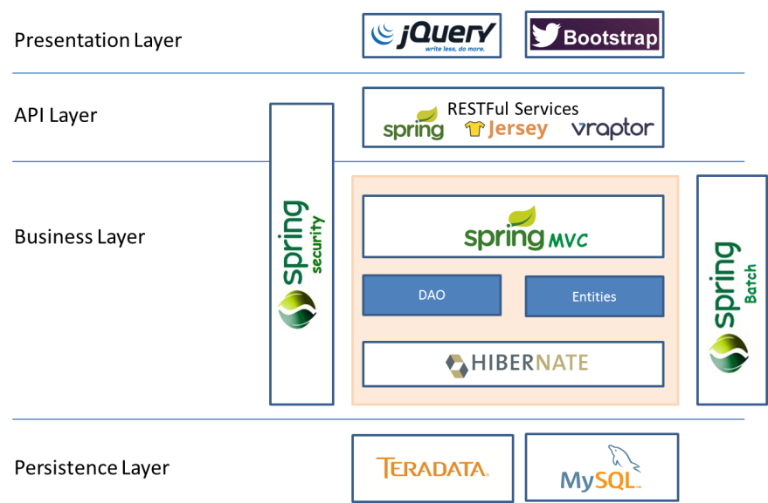

Technology Stack

Slide 11
References
Indian Gov NGO Portal - http://ngo.india.gov.in/view_ngo_details.php?ngo_id=gsm_kumaran&ngo_black=0&t_state=0&t_dist_new3=0&sector_key=0&ngo_name=Global%20Society%20Makers&uniqueid=
Accountability of India's Nonprofits Under Scrutiny - http://content.time.com/time/world/article/0,8599,2036307,00.html

Slide 12
How it works?
NGO/ Needy People
Create Appeals
Volunteers
Can start working on any appeals
Verify and facilitate Appeals
Rewards based on Scoring system [Angel Points]
Committee Members
Own the application
Final Approval
Make the appeals visible to Donors by changing the status to Accept Funds
Generate 80G receipt online
Give Custom scores to the volunteers
Give notifications to the donors
Philanthropists
Notifications based on the area of interest
Can contact the NGO/ Volunteers directly
Can hide their information, if necessary

